Slide 1
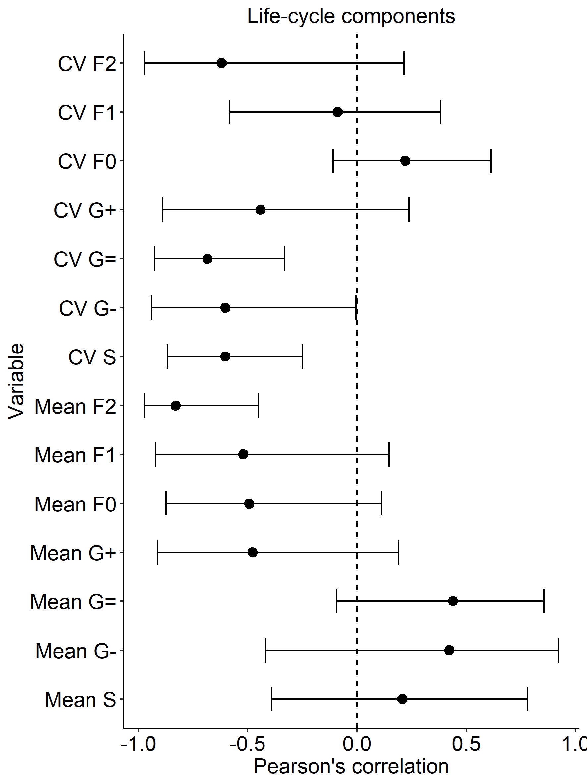
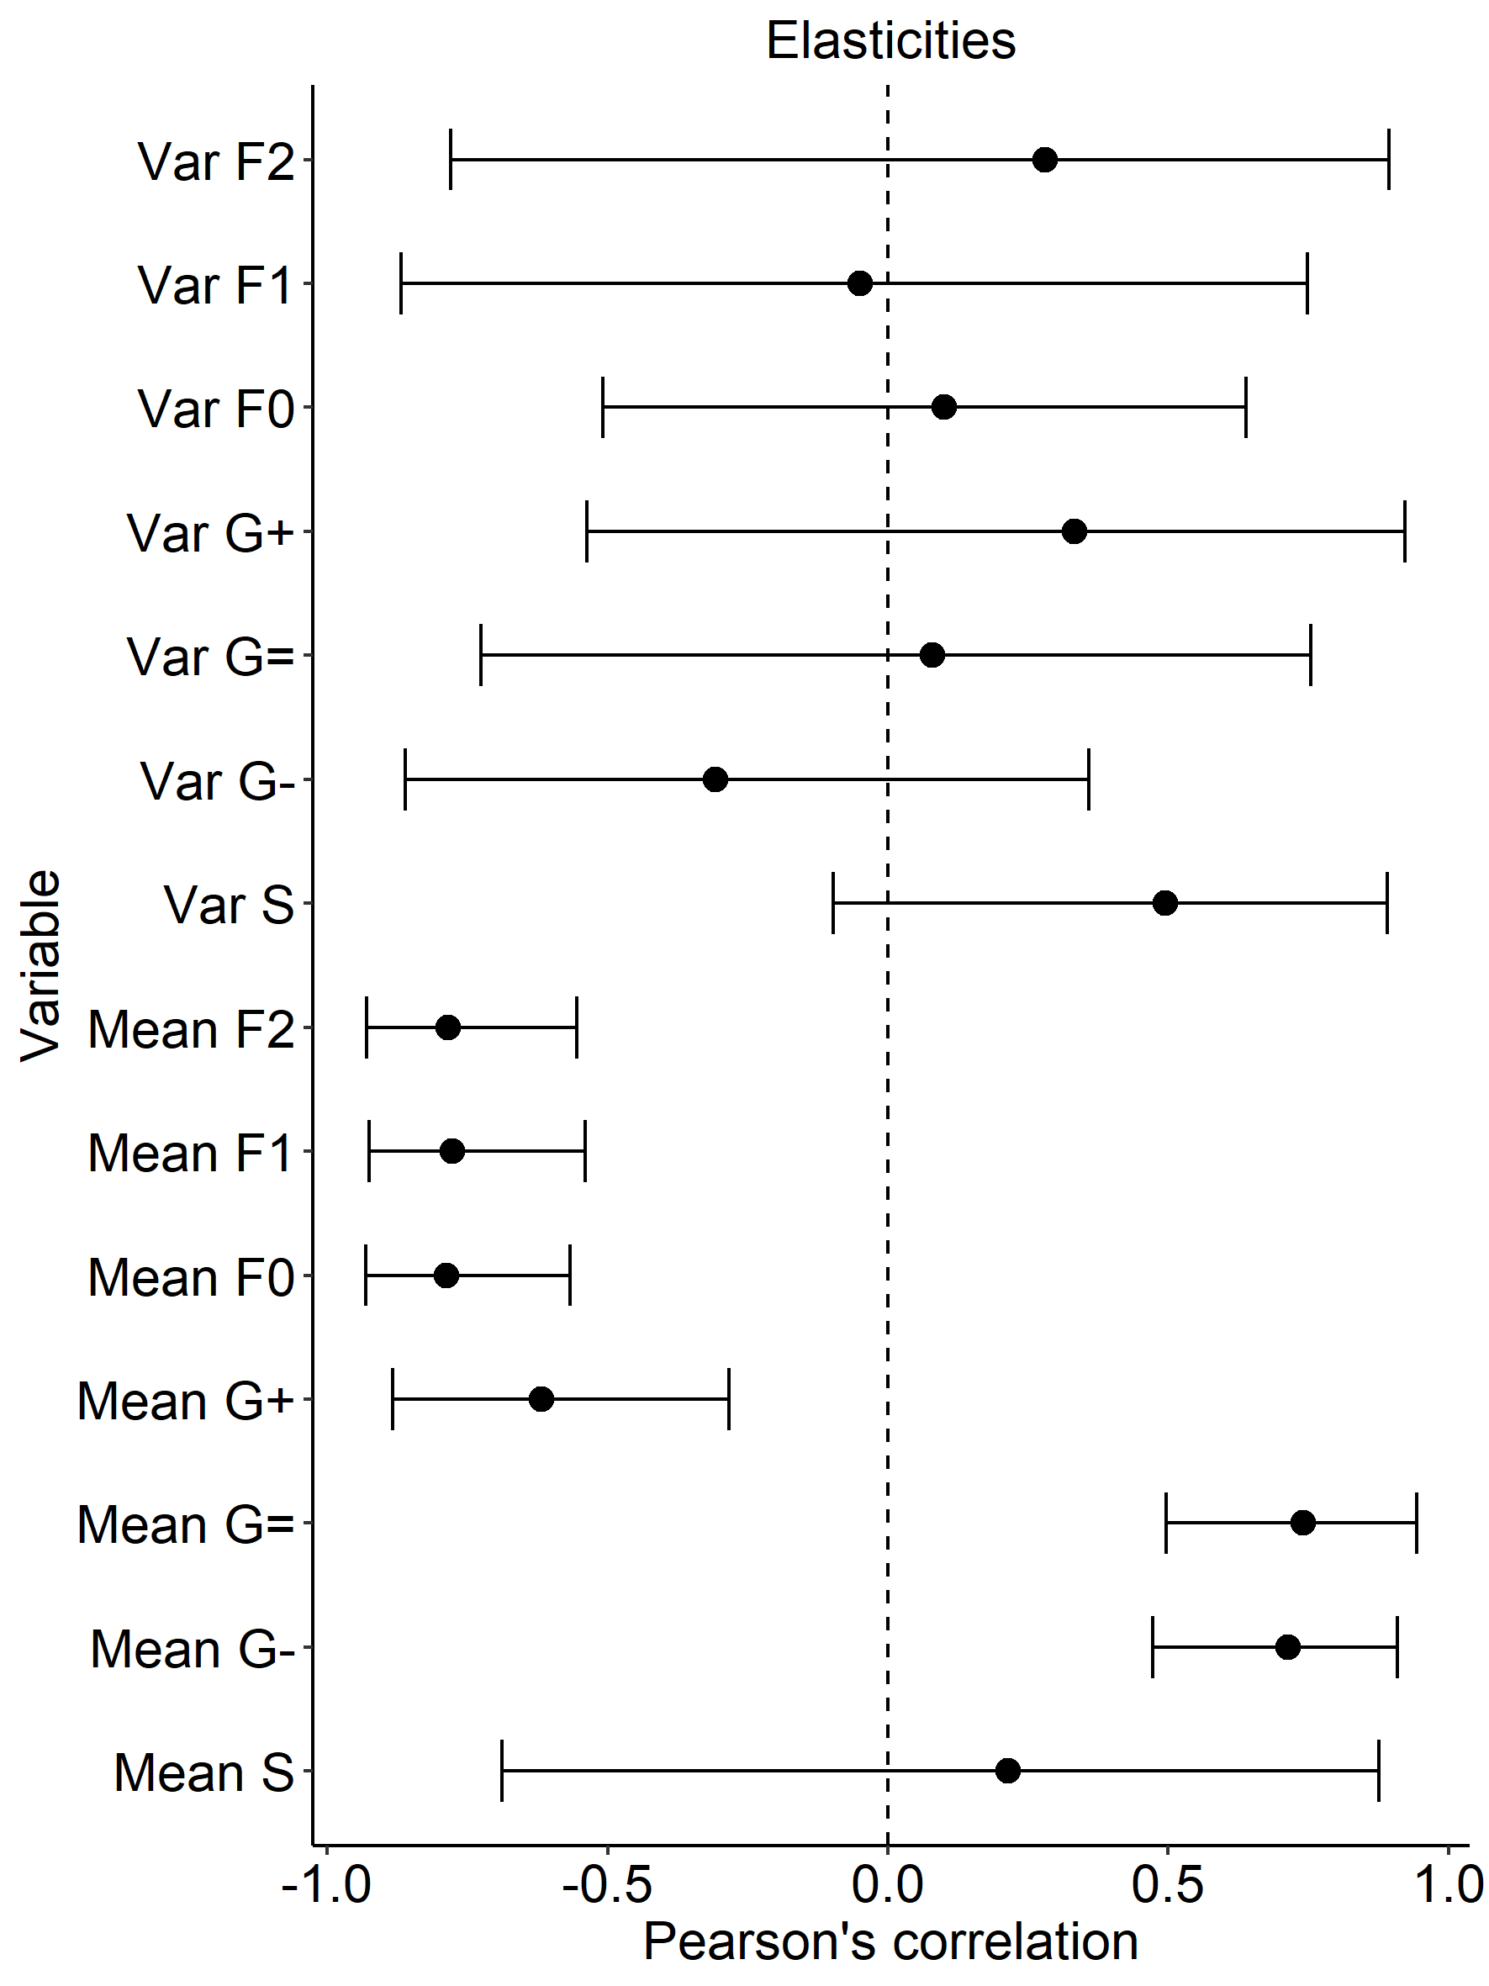
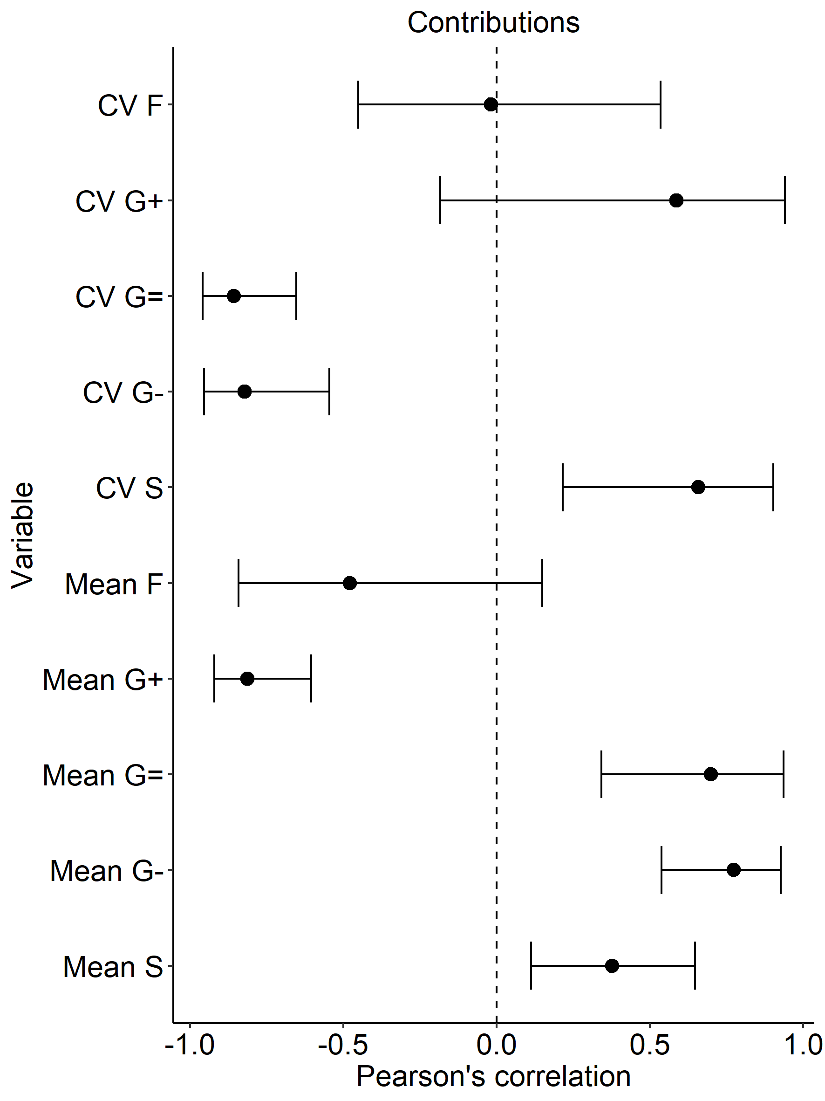
(a) (b) (c)

Slide 2
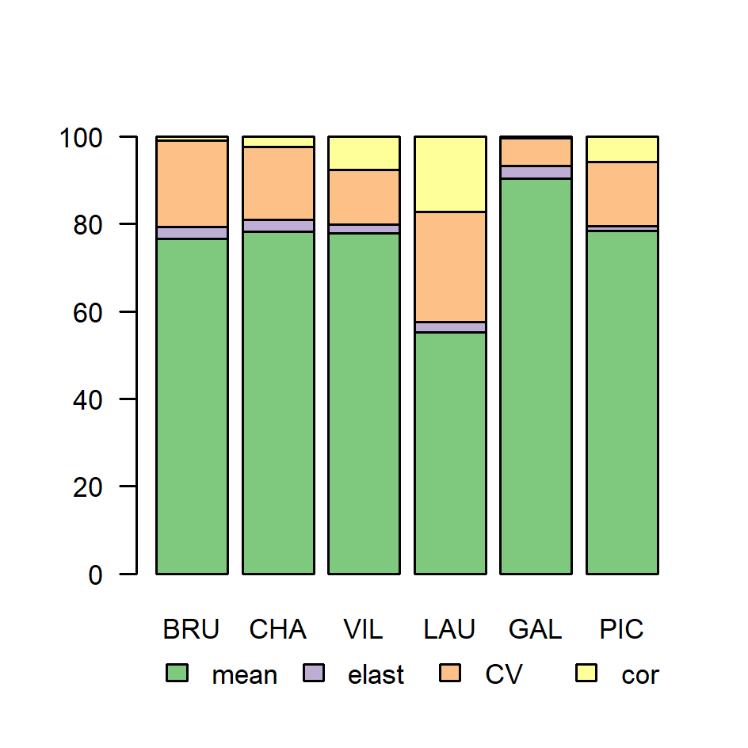
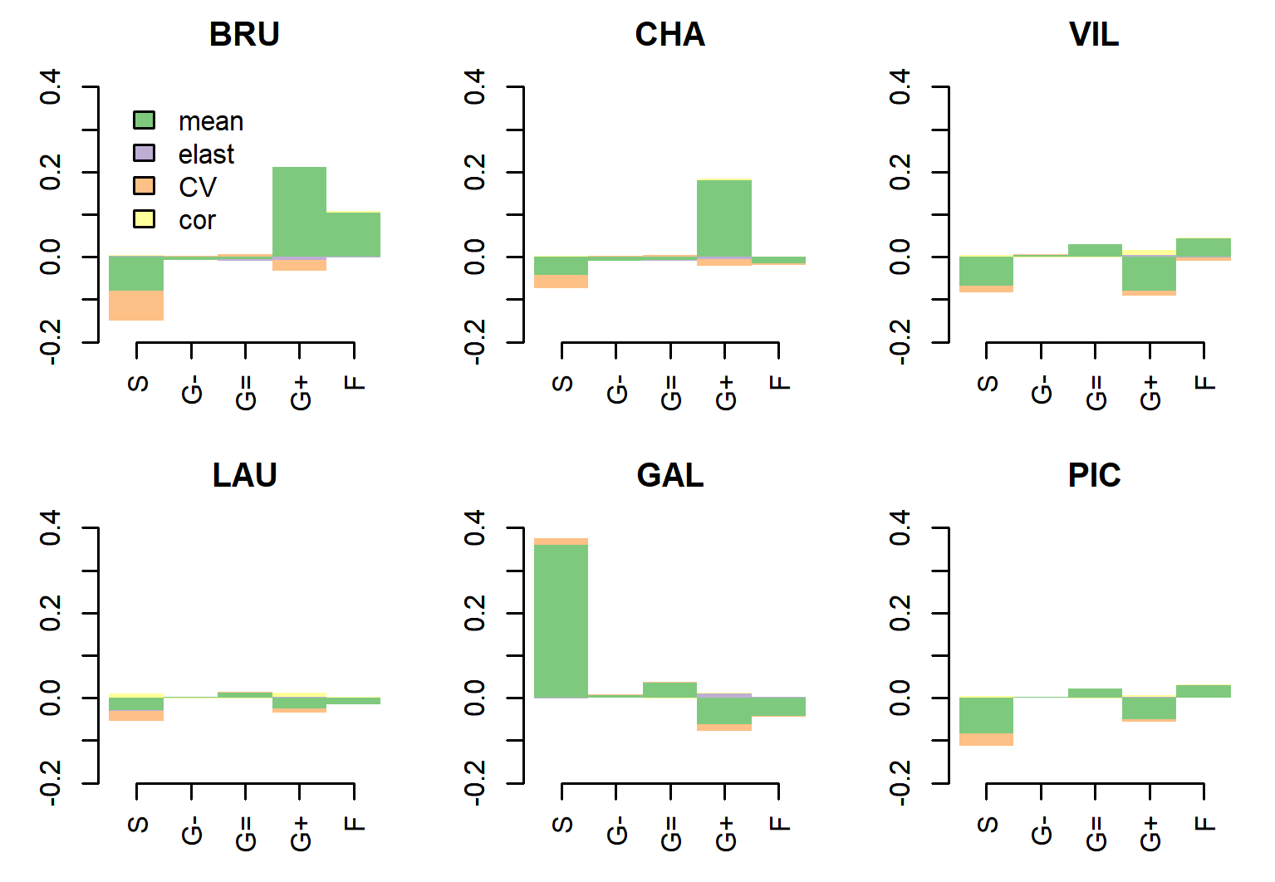
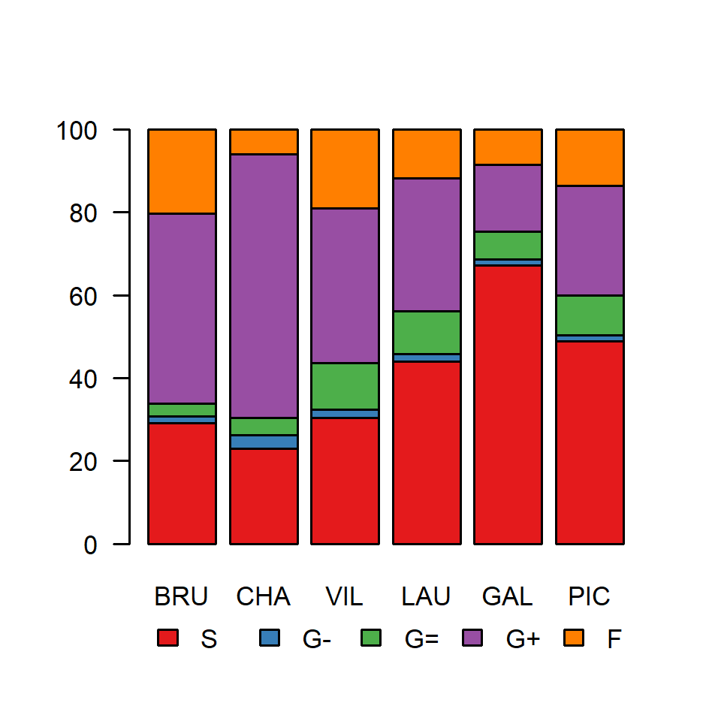
(a) (c) (e) (g)
(b) (d) (f) (h)

Slide 3
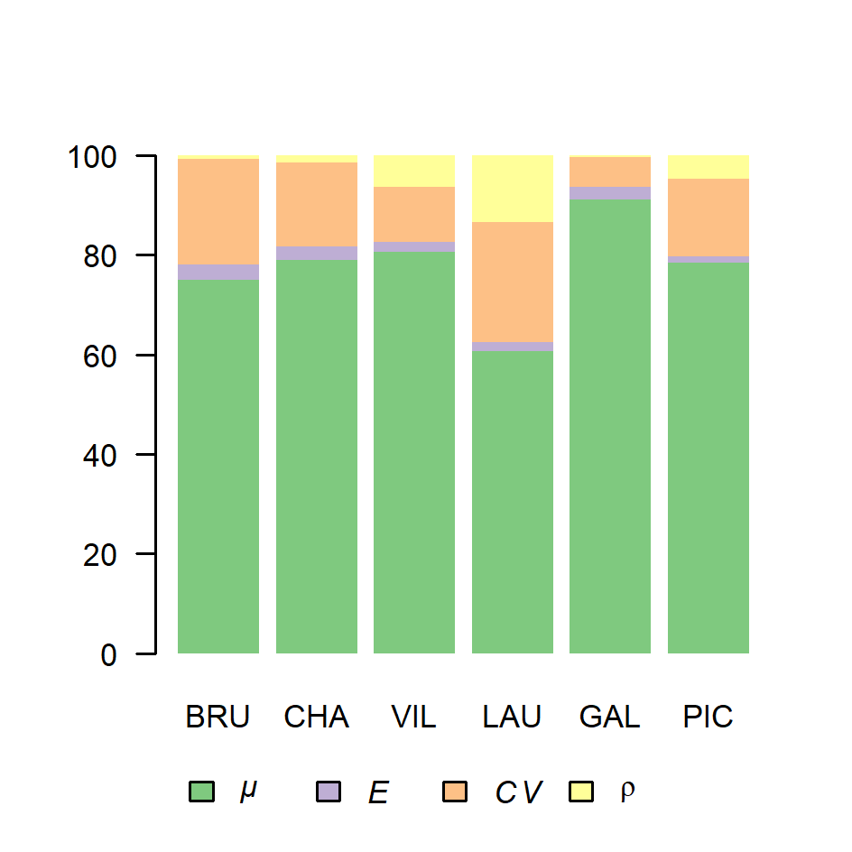
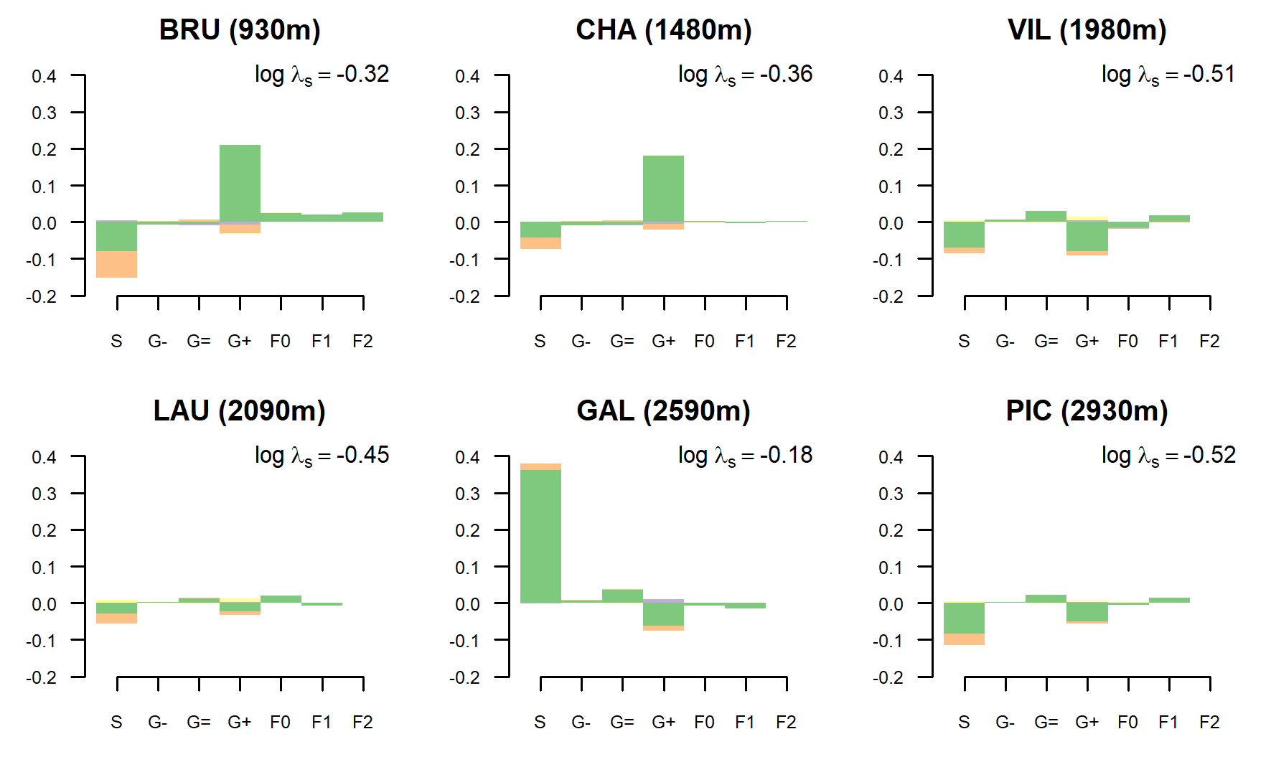
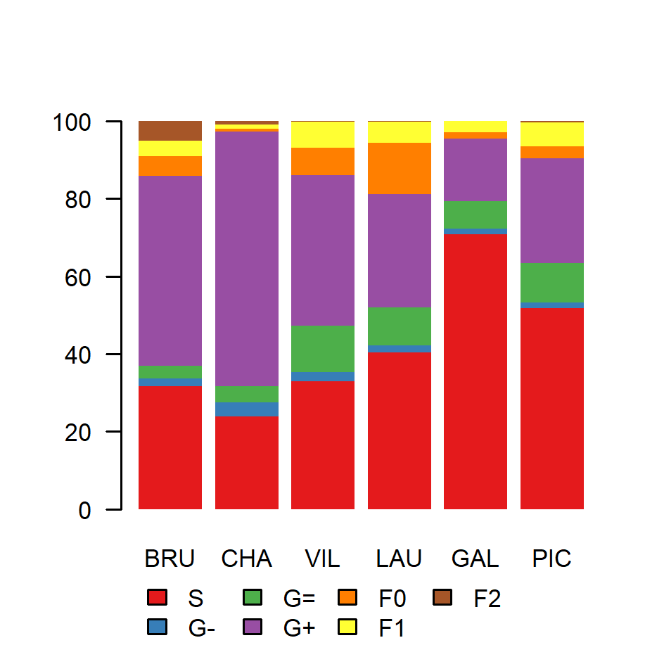
(a) (c) (e) (g)
(b) (d) (f) (h)

Slide 4
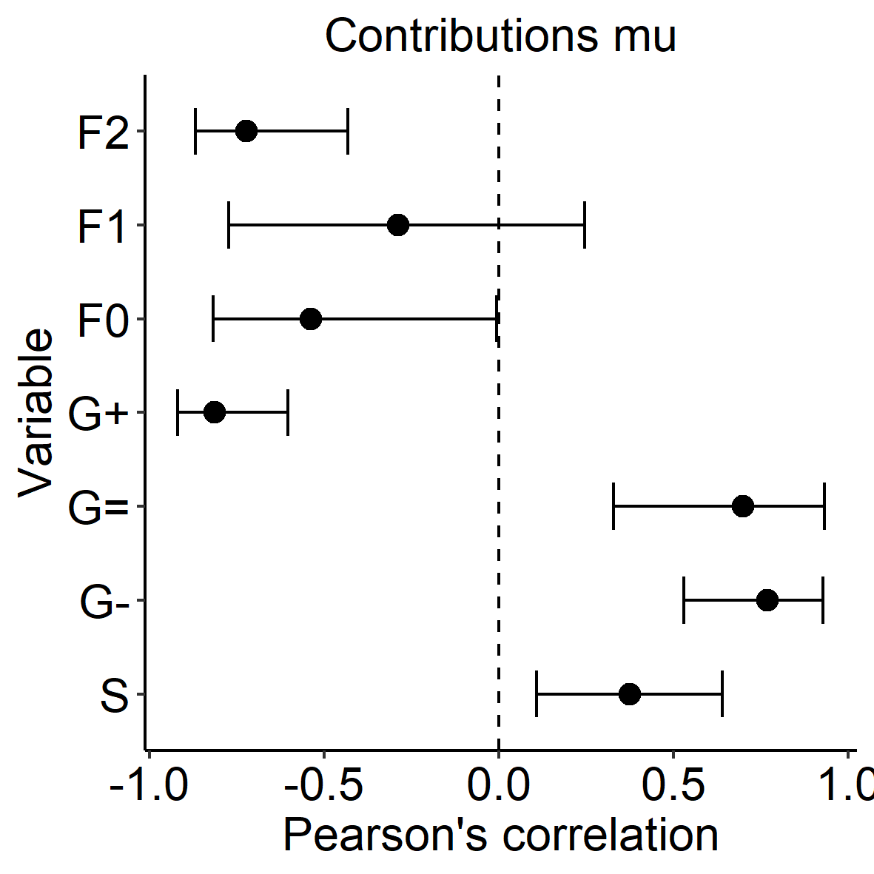
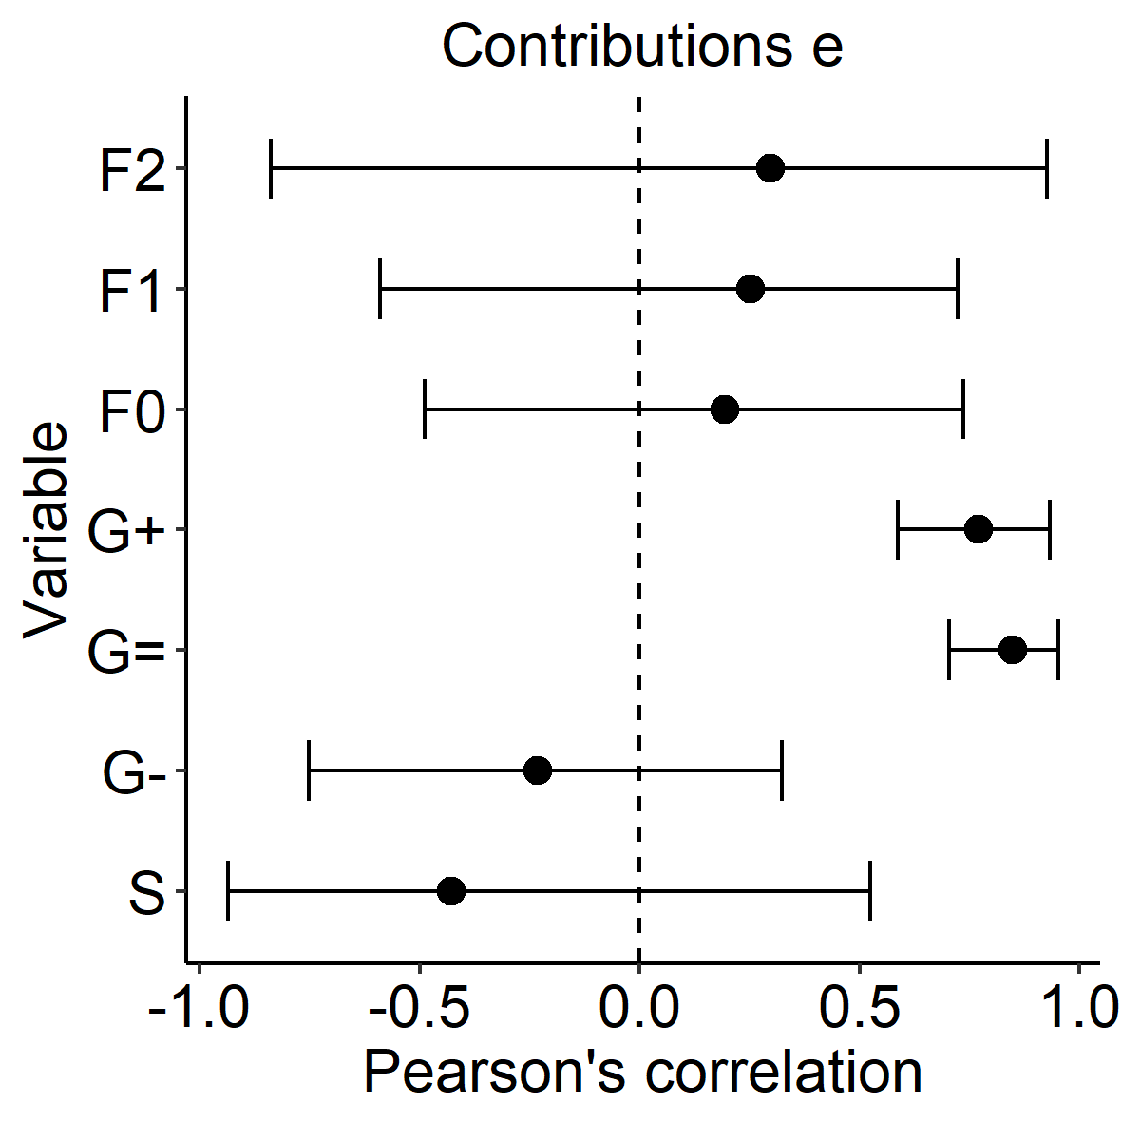
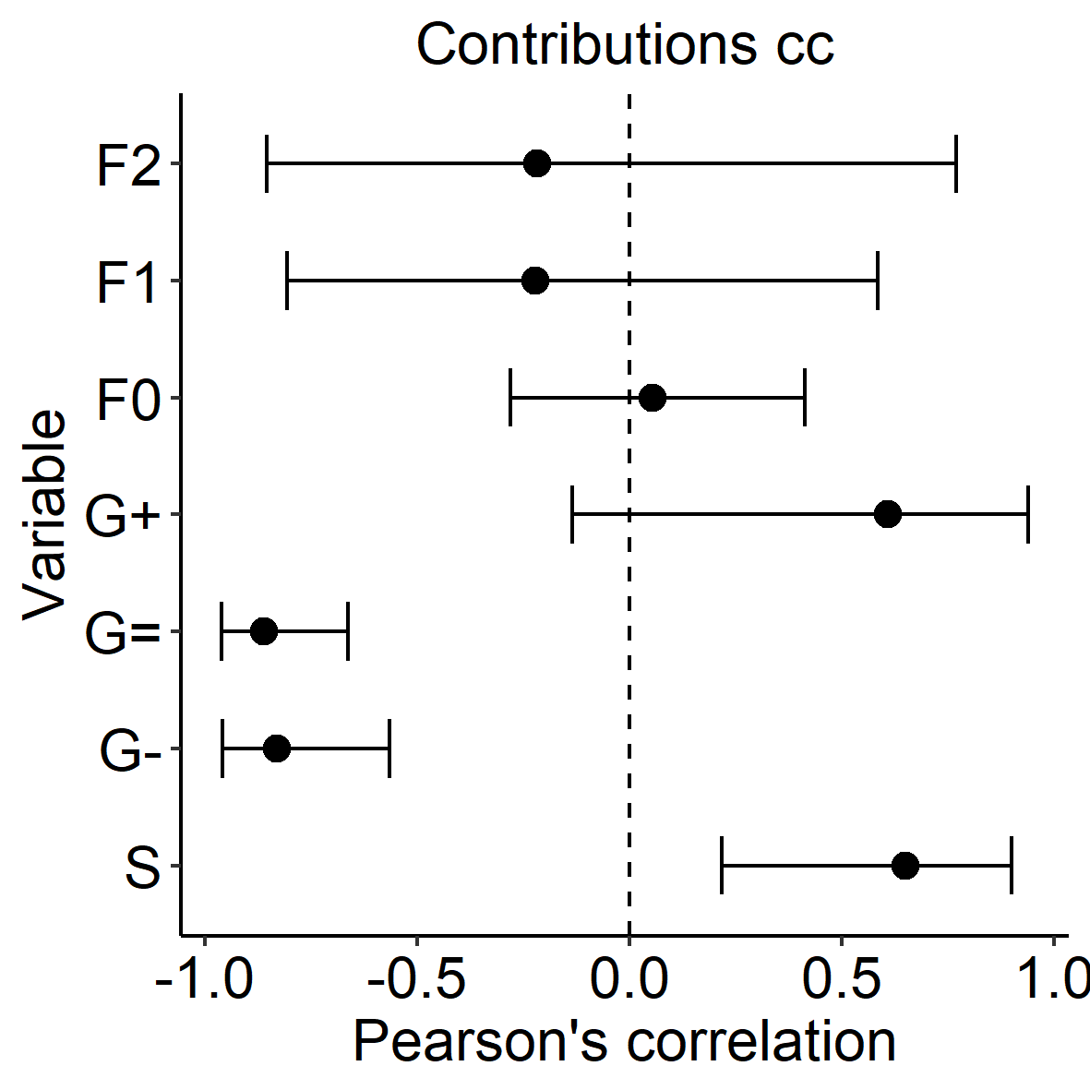
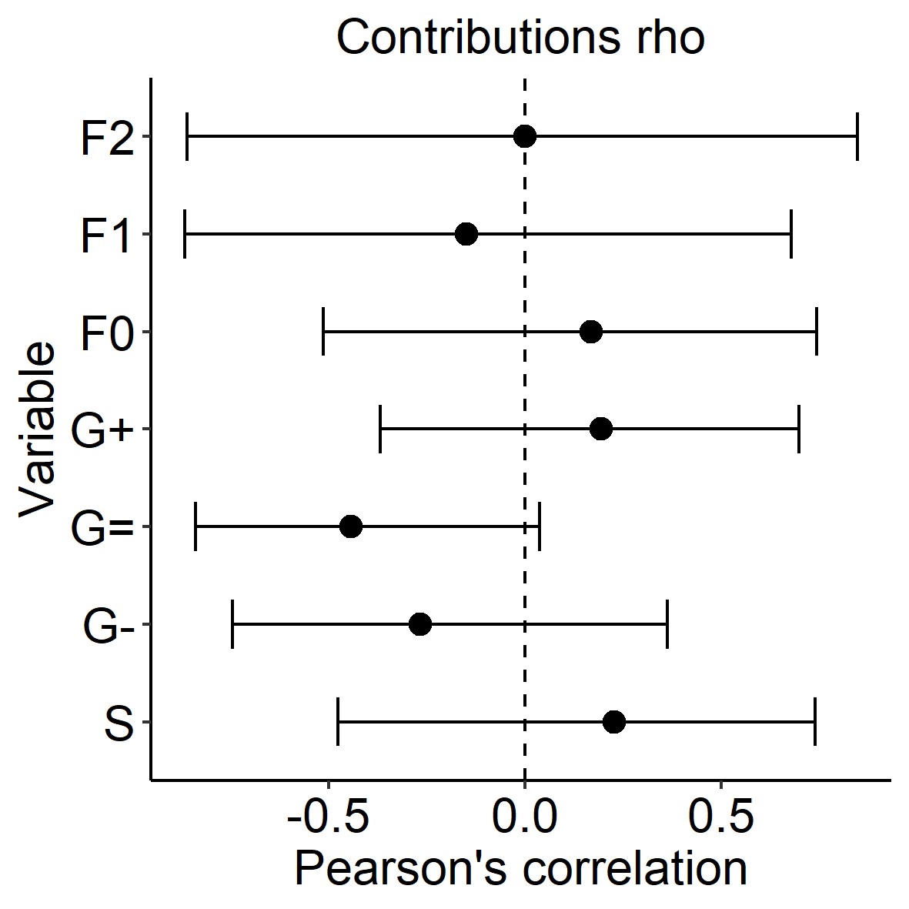
(a) (b)
(c) (d)

Slide 5
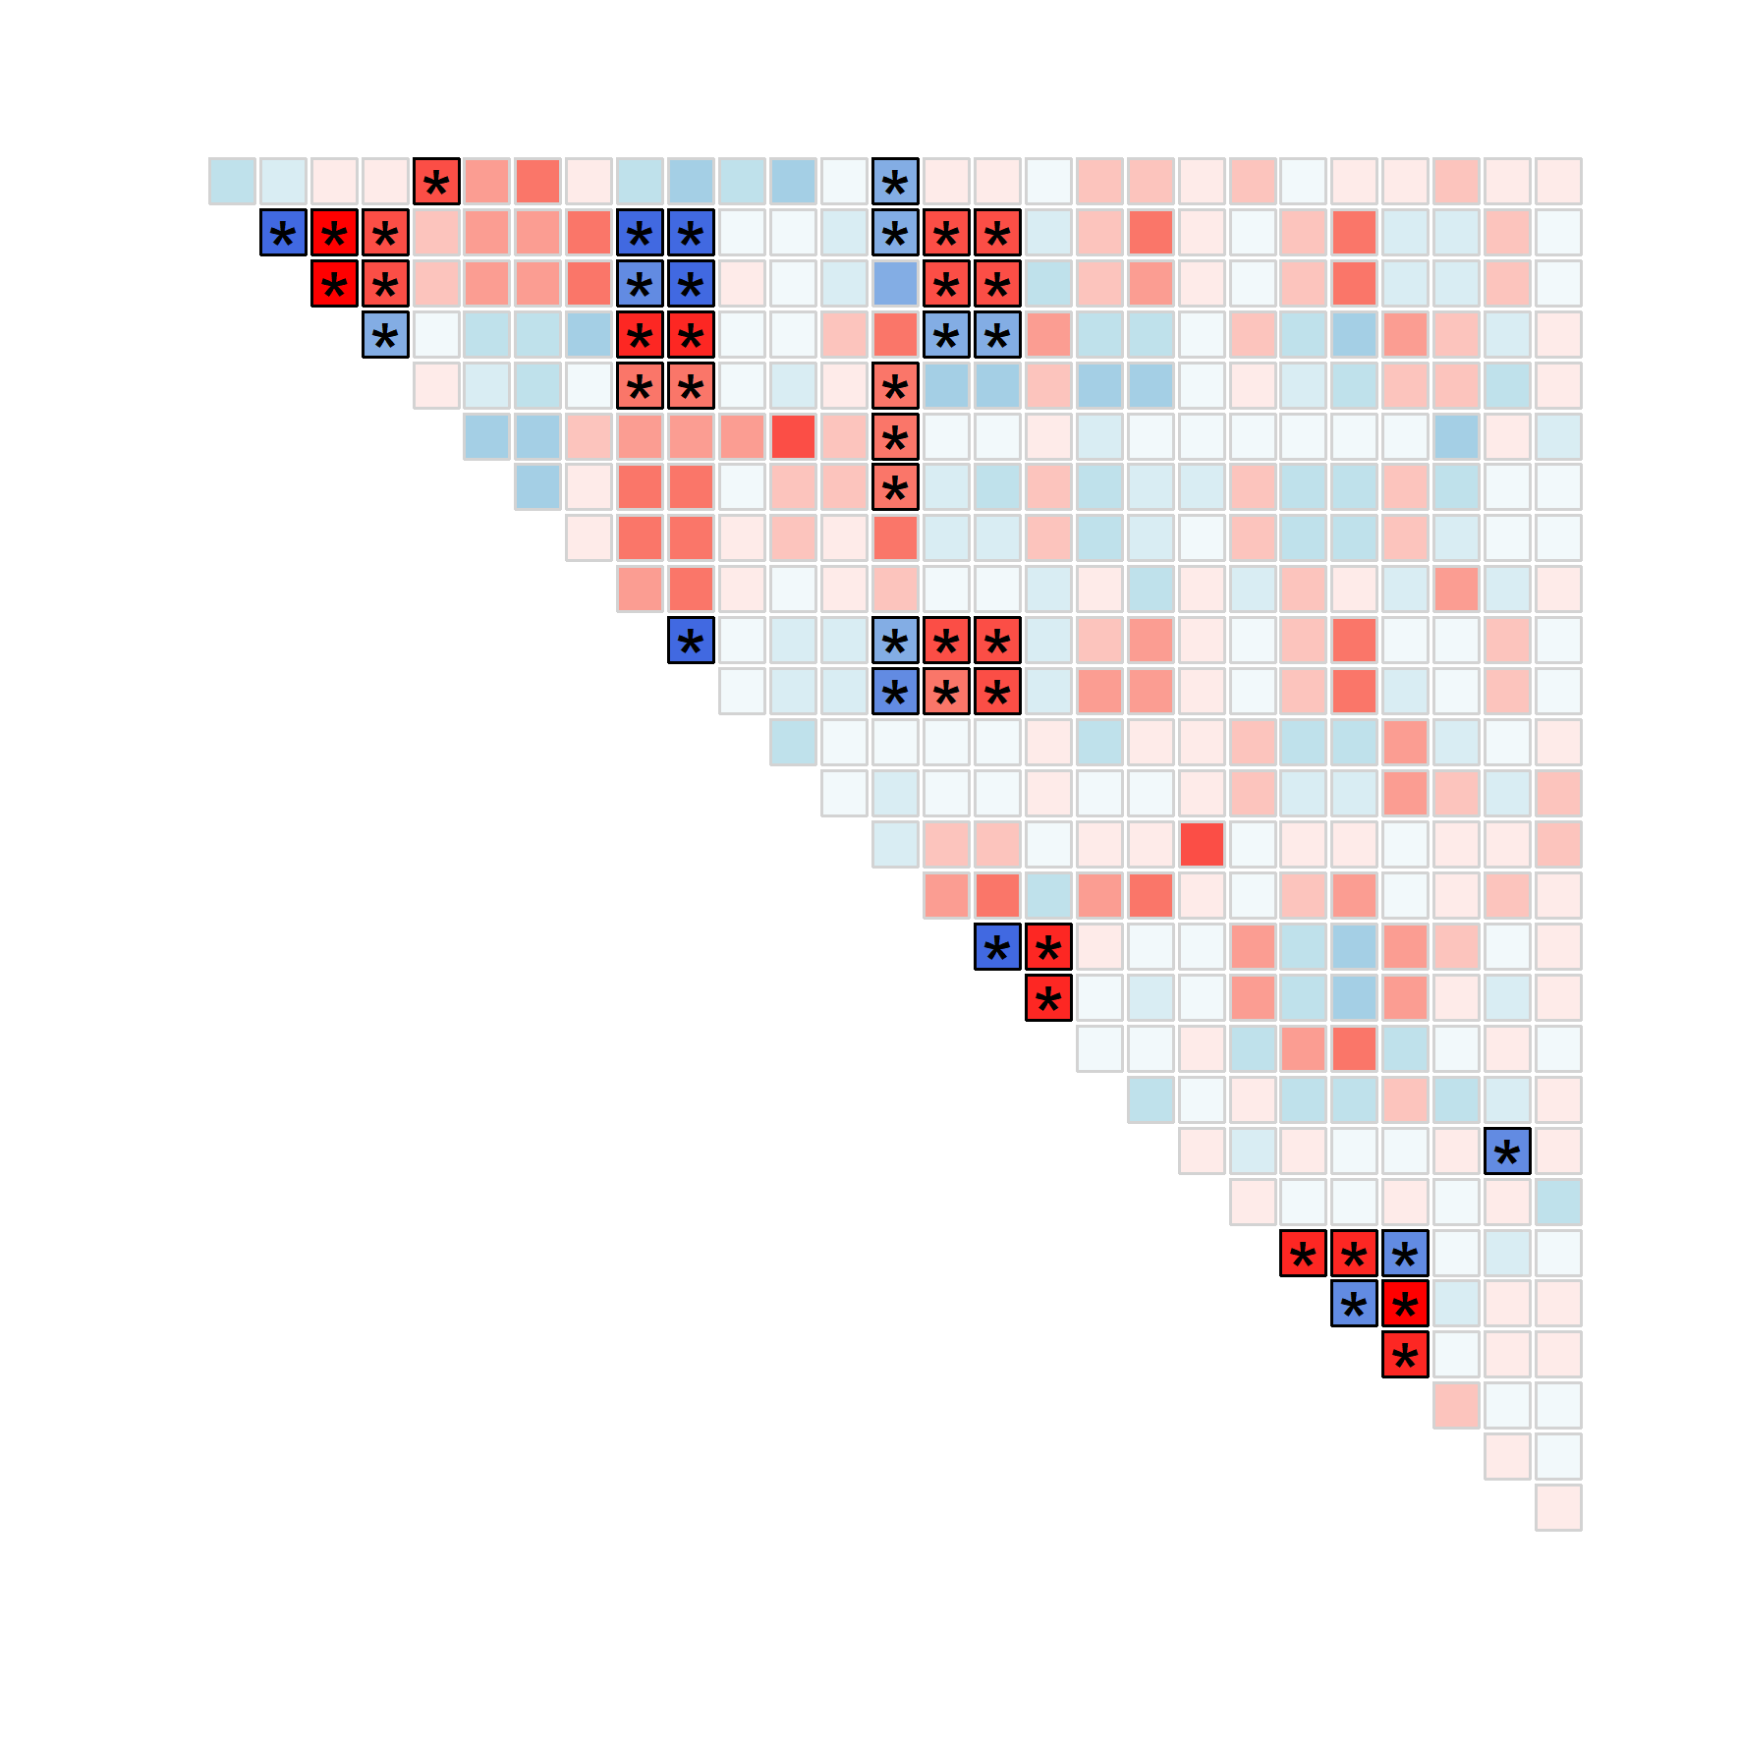
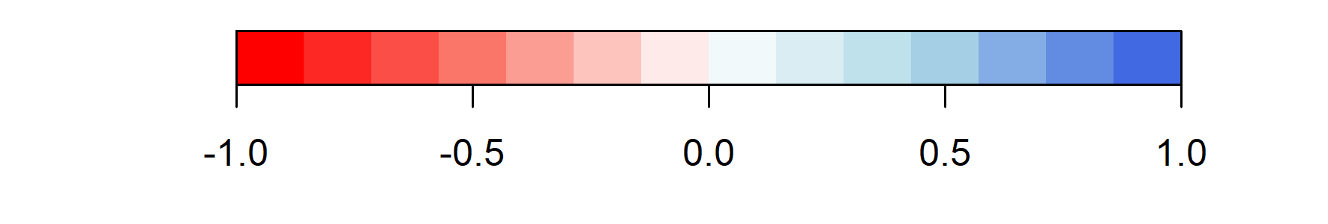
Means Elasticities Temporal variability Temporal correlations
S, µ
G⁻, µ
G⁼, µ
G⁺, µ
F₀, µ
F₁, µ
F₂, µ
S, E
G⁻, E
G⁼, E
G⁺, E
F₀, E
F₁, E
F₂, E
S, CV
G⁻, CV
G⁼, CV
G⁺, CV
F₀, CV
F₁, CV
F₂, CV
Means Elasticities Temporal variability Temporal correlations
S, ρ
G⁻, ρ
G⁼, ρ
G⁺, ρ
F₀, ρ
F₁, ρ
F₂, ρ
Spearman’s correlation coefficient

